Slide 1
Visual Reporting With Connected Design Data
Philippe Leefsma
Principal Developer Advocate
Forge Partner Development
@F3lipek

Slide 2
Class summary
Viewing 3D models on a webpage or in a mobile App is great, but visualizing design data isn’t just about meshes and textures
In this class I will show you how to use JavaScript to turn the Forge Viewer into a powerful visual reporting tool, giving you access to valuable data associated with each model extracted from the original design file and connect your viewing application to external databases &Web APIs to add rich visualization experience
Basic Web development experience is preferable - HTML5 JavaScript, CSS, Web Services, REST API’s, …

Slide 3
Key learning objectives
At the end of this class, you will be able to:
Access and manipulate the data which is available out of the box with your Forge Viewer models
Explore various way of overlaying and embedding custom graphics into the Viewer
Learn how to create powerful, highly customized visual applications integrating elements from multiple data sources
Leverage the Forge Model Derivative API to access and manipulate design data in the cloud

Slide 4
Agenda
Accessing Forge Design Data
UI Customization
Connecting your App to the Cloud

Slide 5
I - Accessing Forge Design Data

Slide 6
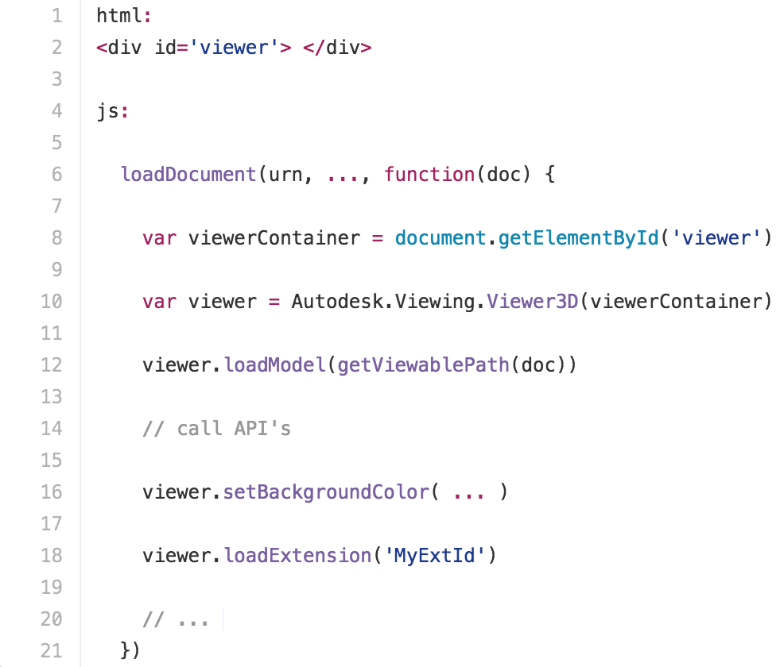
Accessing the Viewer API
Notes:
Accessing the API
html: <div id='viewer'> </div> js: function load (urn) { initializationStuff(urn, ..., function(svf) { var viewerContainer = document.getElementById('viewer') var viewer = Autodesk.Viewing.Viewer3D(viewerContainer) viewer.loadModel(getViewablePath(svf)) // call API's viewer.setBackgroundColor( ... ) viewer.loadExtension('MyExtId') // ... }) }

Slide 7
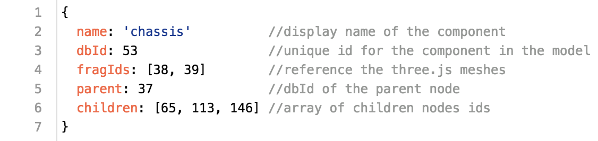
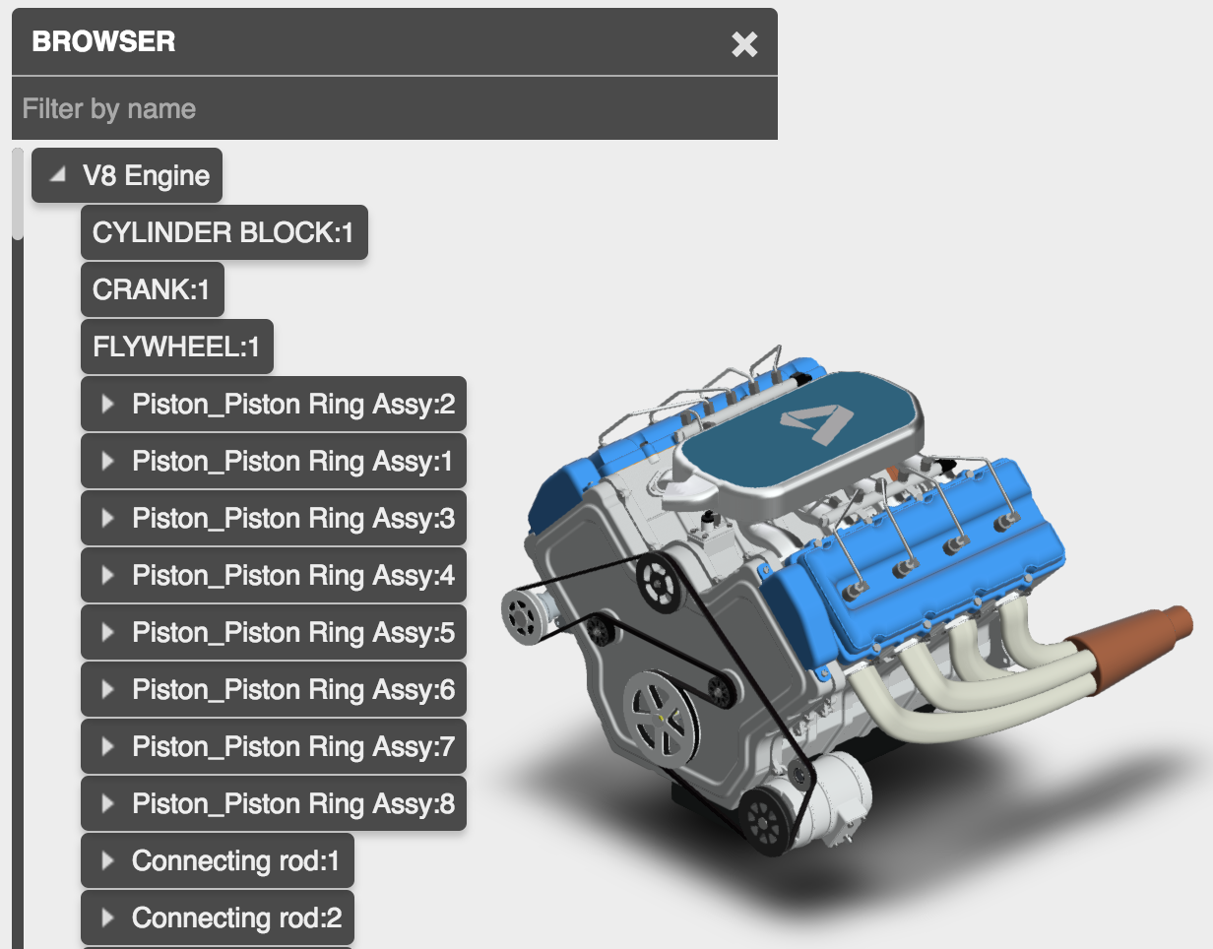
Viewer Component Model
Notes:
VIEWER COMPONENT MODEL

Slide 8
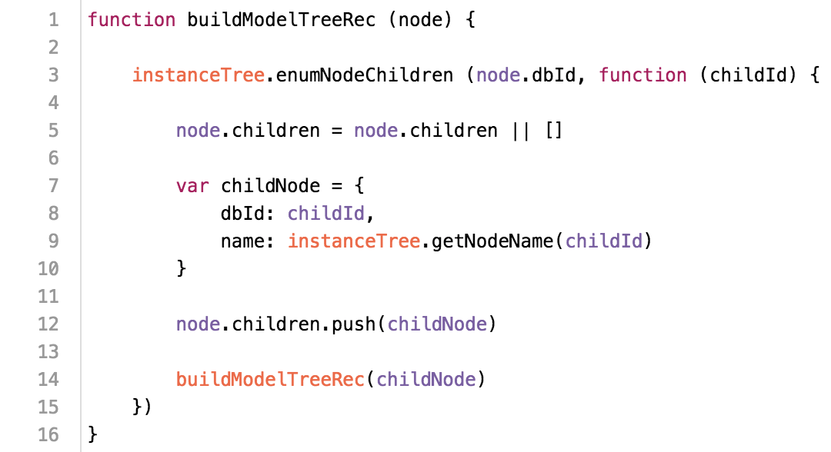
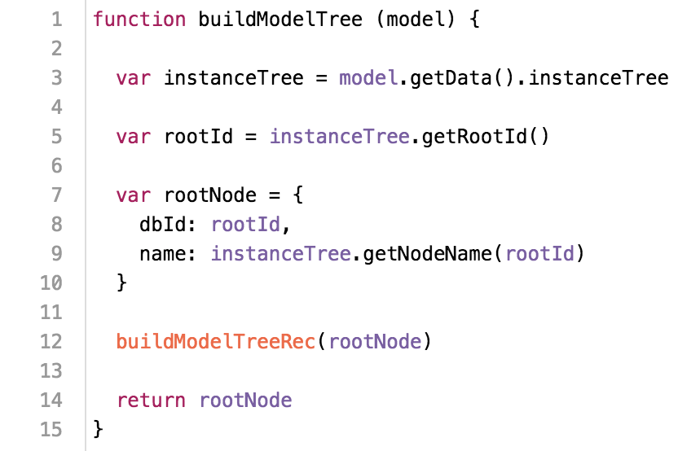
Model Structure

Slide 9
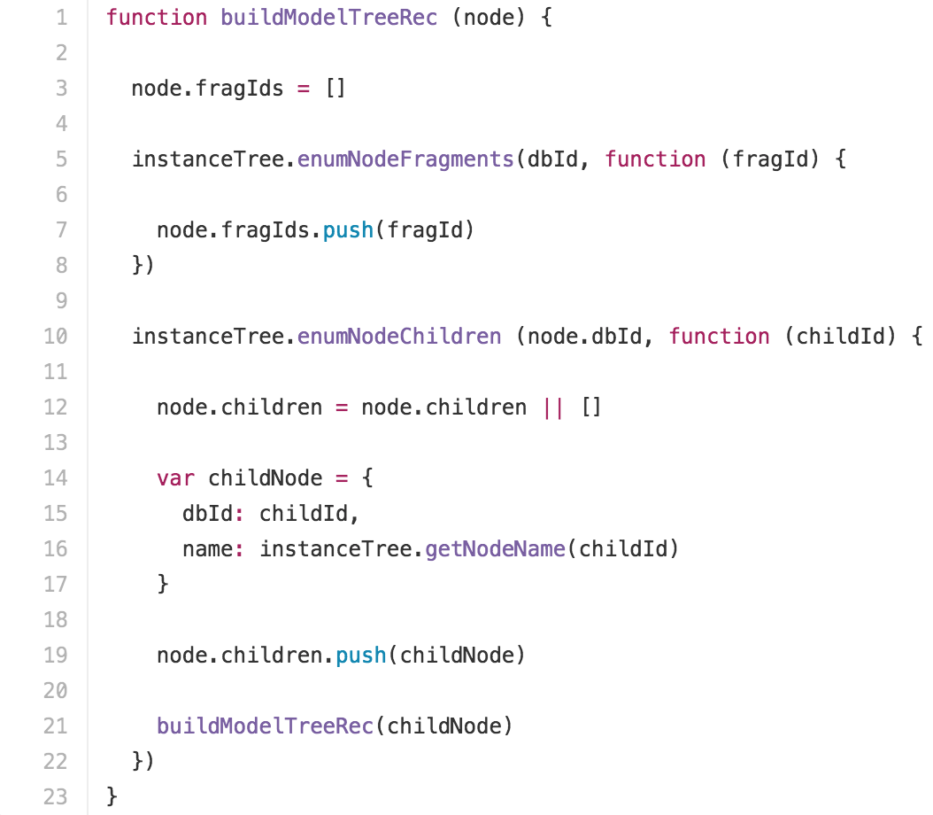
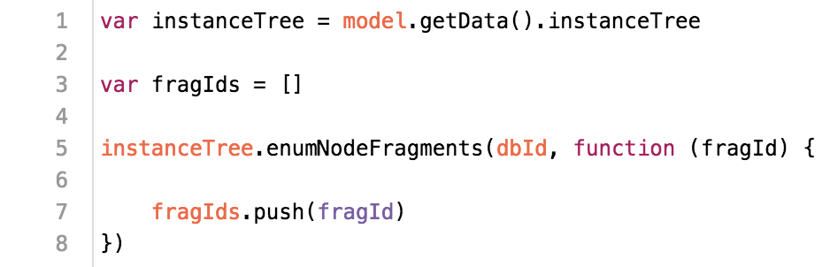
Node Fragments

Slide 10
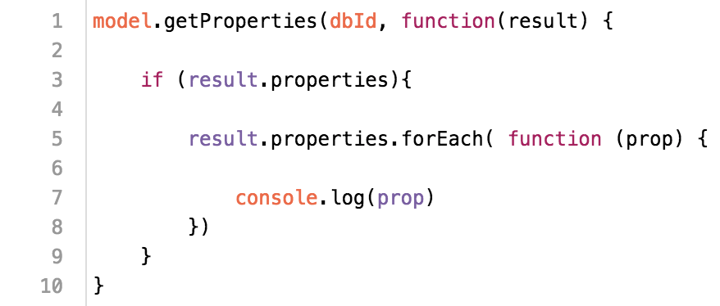
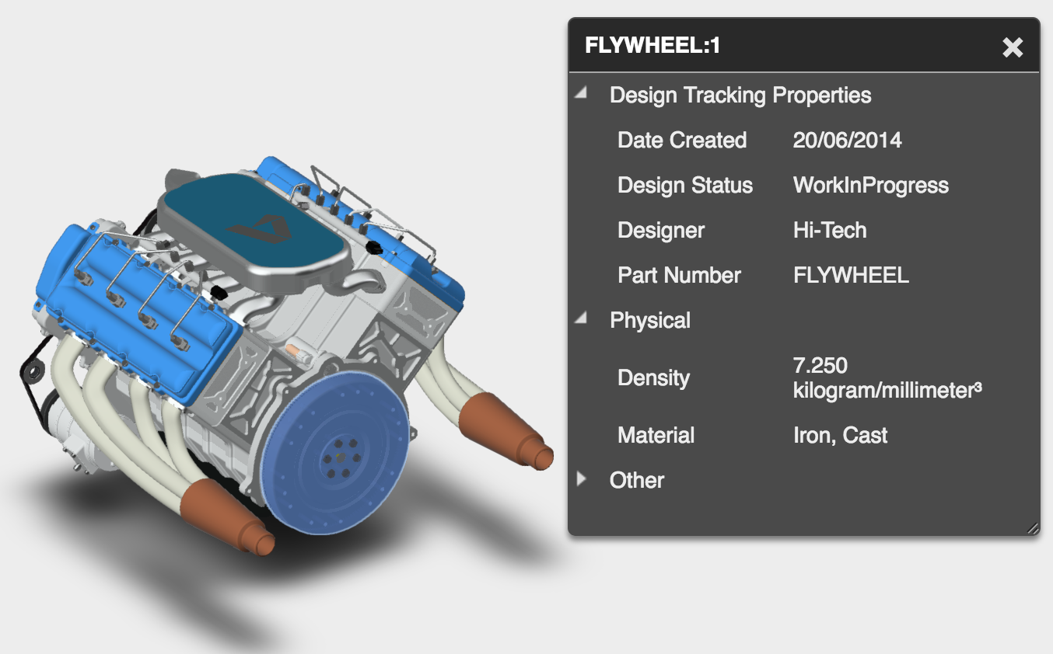
Component Properties

Slide 11
II - UI Customization

Slide 12

2D Overlays

Slide 13
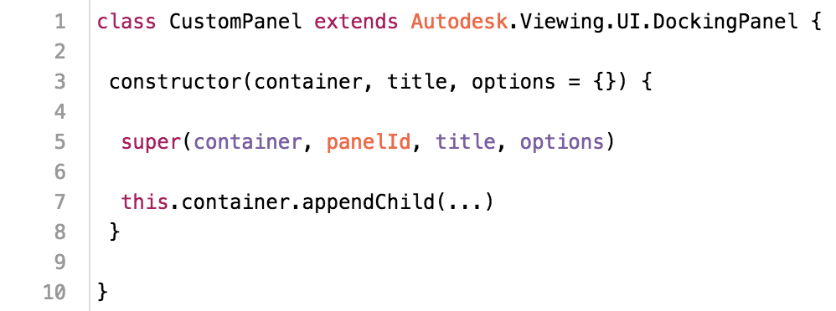
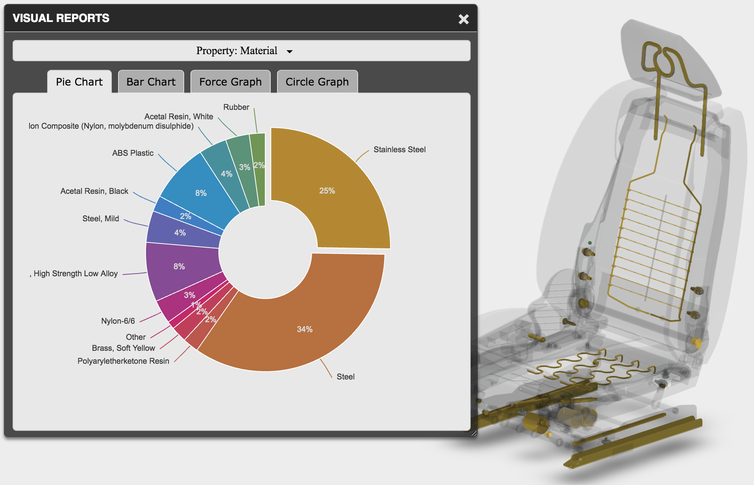
Custom Panel

Slide 14
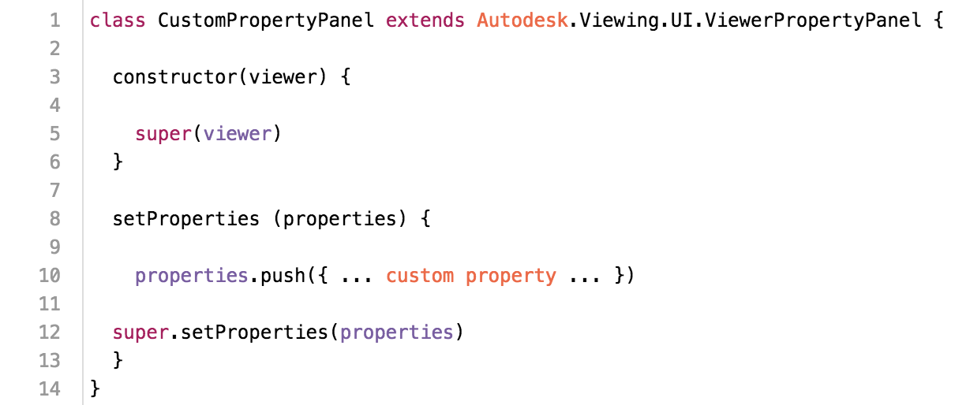
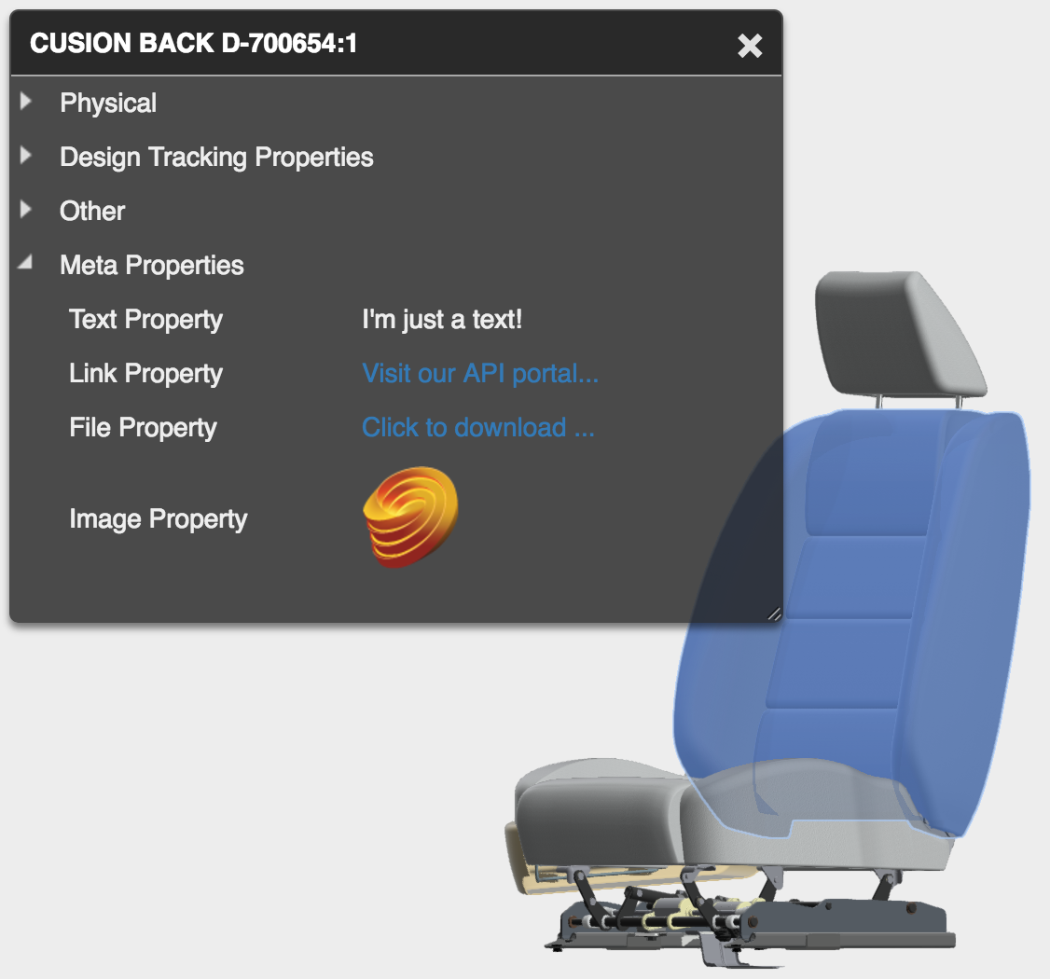
Custom Property Panel

Slide 15
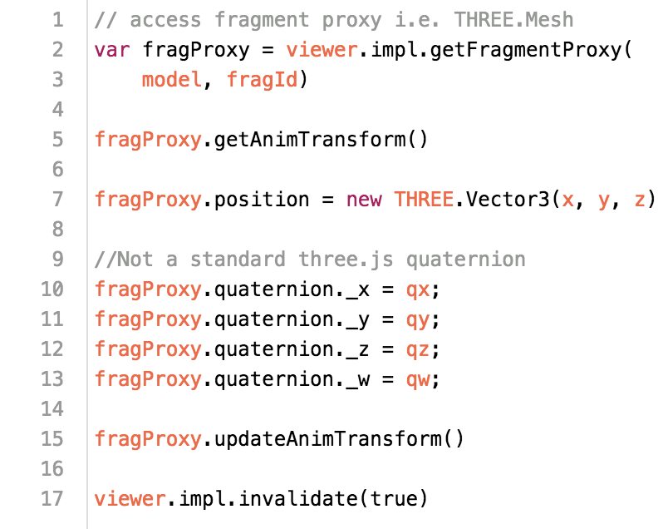
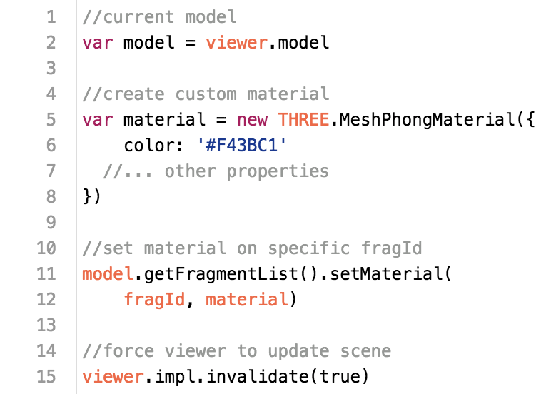
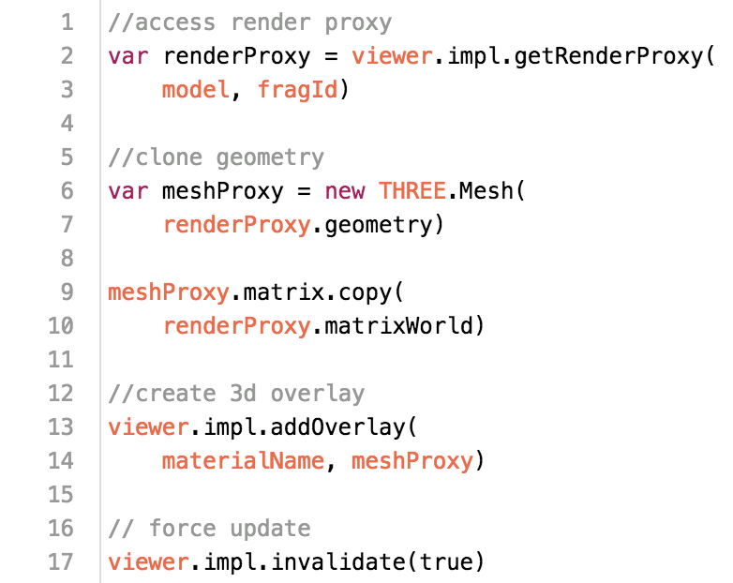
Fragments Overrides

Slide 16
SVG
Scalable Vector Graphics (SVG) is an XML-based markup language for describing two-dimensional vector graphics. SVG is essentially to graphics what HTML is to text

Slide 17
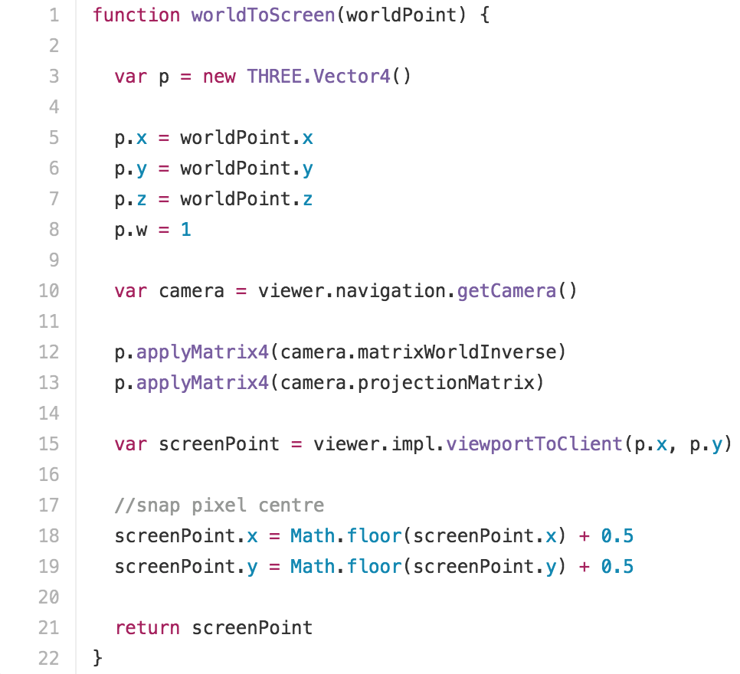
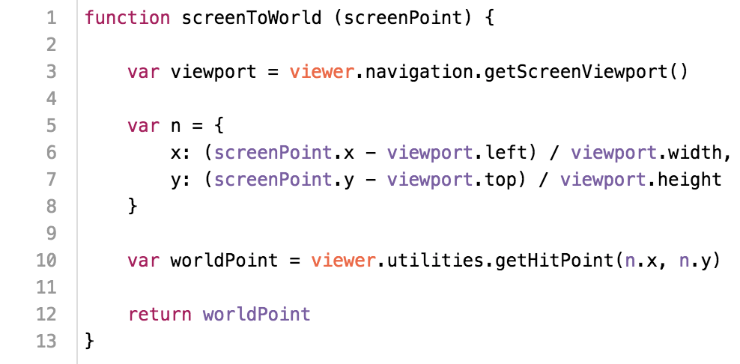
Coordinates Conversion

Slide 18
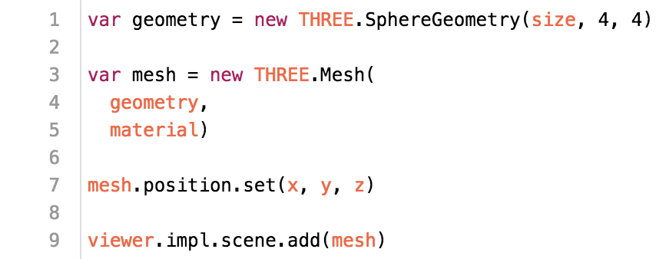
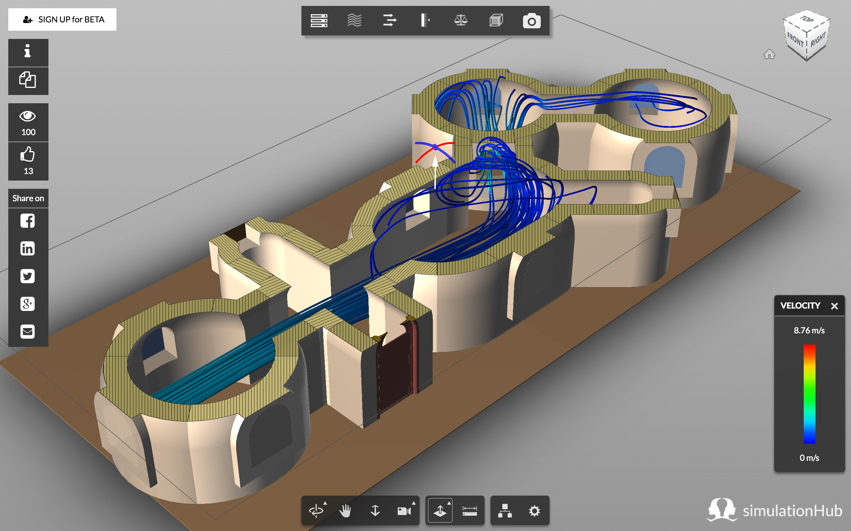
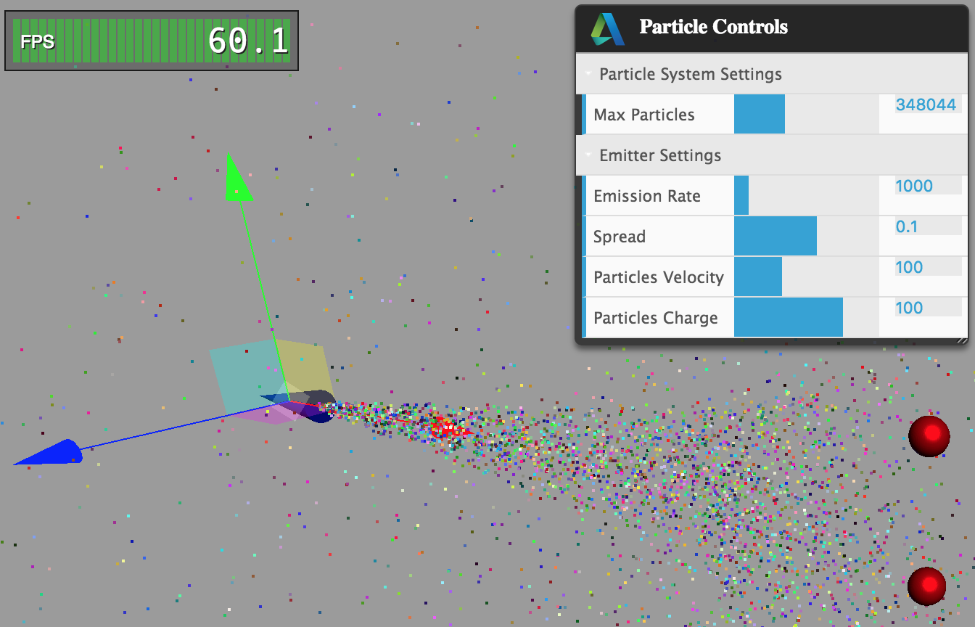
3D Overlays & Custom meshes

Slide 19
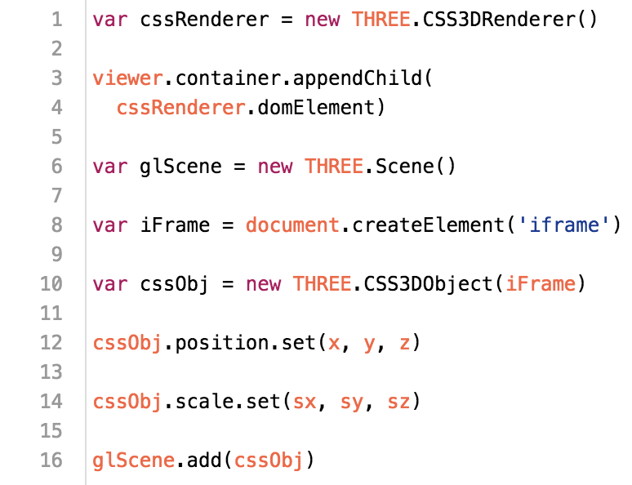
CSS3DRenderer & CSS3DObject

Slide 20
III - Connecting your App to the Cloud

Slide 21
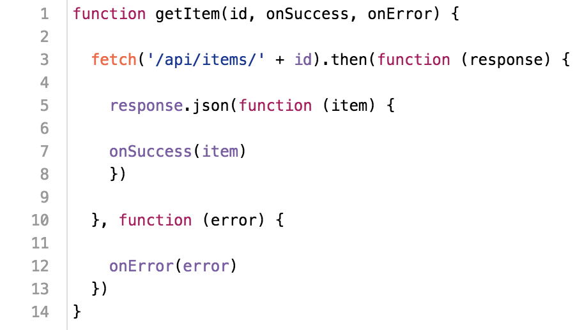
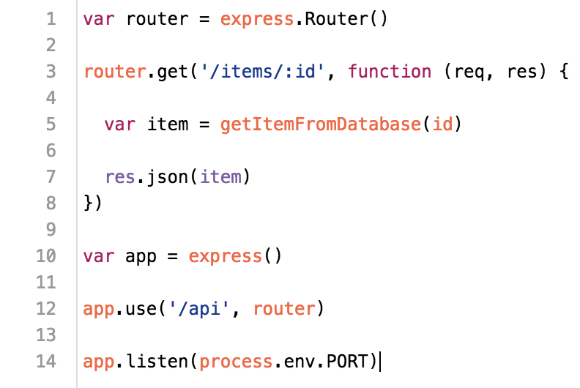
REST API - Node.Js

Slide 22
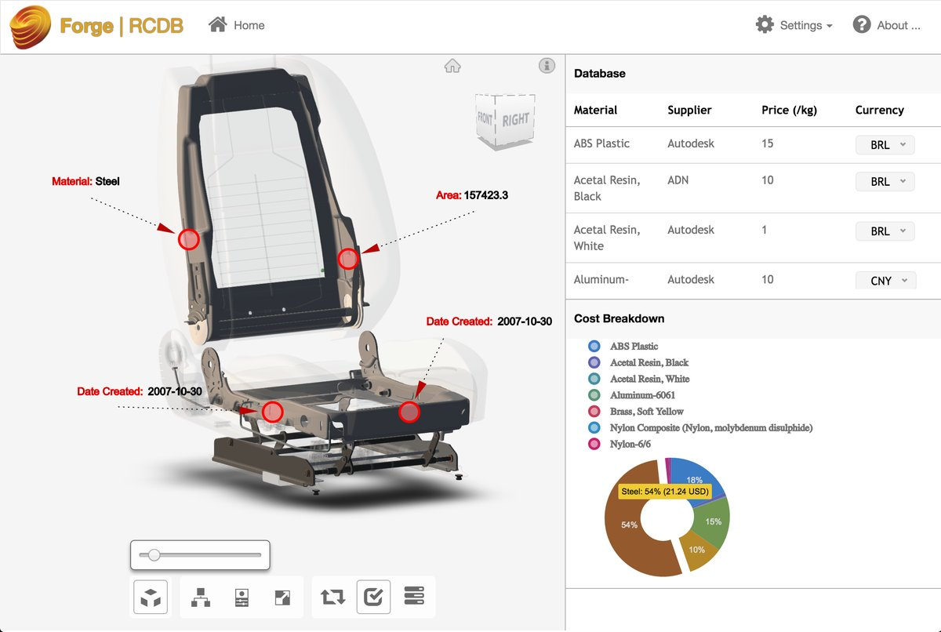
Forge RCDB - https://forge-rcdb.autodesk.io

Slide 23

How did I do … ?
Your class feedback is critical. Fill out a class survey now.
Use the AU mobile app or fill out a class survey online.
Give feedback after each session.
AU speakers will get feedback in real-time.
Your feedback results in better classes and a better AU experience.

Slide 24

More Questions? Visit the AU Answer Bar
Seek answers to all of your technical product questions by visiting the Answer Bar.
Open daily from 8am-6pm Tuesday and Wednesday; 8am-4:30pm Thursday.
Located outside Hall C, Level 2.
Meet Autodesk developers, testers, & support engineers ready to help with your most challenging technical questions.

